Slide 1
This presentation is inspired by Shark Tank and uses references to WALL-E.
Notes:
Images used in this slideshow that were not AI Generated:
LiNUS waving “hello”: https://news.nus.edu.sg/nus-open-house-2022-interdisciplinary-offerings-in-person-activities-and-more/
WALL-E figurines: https://www.ilovecharacters.com/products/disney-pixar-wall-e-m-o-and-eve-storytellers-figure-set-toy-new-with-box?srsltid=AfmBOop_AOVoF_Yb9ZjkueC9jE5l3_DaV-y6jMDCYGavTk2pFSW-qzCU
WALL-E poster: https://www.themoviedb.org/movie/10681-wall-e/images/posters
Ikea instruction manual: https://justinzhuang.com/posts/wordless-instructions/
Buzzer: https://www.flyrobo.in/3.5-5.5v_standard_passive_buzzer_module_for_arduino?srsltid=AfmBOoq88500ukUD4EjcGrf9uCo_v_YWiLjJyiUV_K56N1kz5FBz37Wo
ESP32: https://www.amazon.sg/ESP32-WROOM-32-Development-ESP-32S-Bluetooth-Compatible-Arduino/dp/B084KWNMM4
Red LED: https://ph.rs-online.com/web/p/leds/1278393?srsltid=AfmBOopb3c0pu7uGCuiiKrd5NQfqx_Te9RRSqQIwTsIIWIuc0ae9Ex1K
Green LED: https://sg.rs-online.com/web/p/leds/2545714?srsltid=AfmBOoprMIEvZHbRxiFmlhhNDlChqri2jsz5c-ZcowdOTthrkjDPISG2
Button: https://electrosome.com/switch-arduino-uno/
Ultrasonic sensor: https://sg.cytron.io/p-3v-5.5v-ultrasonic-ranging-module?srsltid=AfmBOoo1eSY7u_wAMmkgp24SjzMDJHtKfGnR_Q-4dGBbiLhlDQrExSr9
Mecanum wheels: https://robu.in/product/80mm-a-mecanum-wheel-compatible-with-6-7mm-coupling-pack-of-4-yellow/
Motors: https://botland.store/geared-dc-angle-motors/16016-dc-motor-with-148-gear-3-6v-with-double-sided-shaft-200rpm-5904422344078.html
Basket: https://www.walmart.com/ip/Sterilite-Medium-Ultra-Plastic-Storage-Organizer-Basket-White-12-Pack/809340548
ESP32Cam: https://www.instructables.com/How-to-Use-the-ESP32-CAM-for-Beginners/
IMU: https://coremach.shop/product/757428320017/?table=products_009
Drawstring Backpack: https://www.diadora.com/en/sg/drawstring_bag/103.180335_65151.html?srsltid=AfmBOopXs1GvcVUwM3a_74CT-X3O5Fi9ByJ9-erGxIt-OGyUFDpvtExo
Cardboard: https://www.indiamart.com/proddetail/white-cardboard-sheet-15667971655.html
April Tag: https://www.researchgate.net/figure/Exemplary-AprilTag-tag-42-from-the-36h11-family_fig5_336614405
Waistpack: https://apxofficialstore.com/product/nike-running-bag-slim-waistpack-3-0-printed-cargo-khaki-medium-olive-blsck-silver-n-100-3730-305/
Finger pointing: https://commons.wikimedia.org/wiki/File:Indikanta_fingro.png

Slide 2

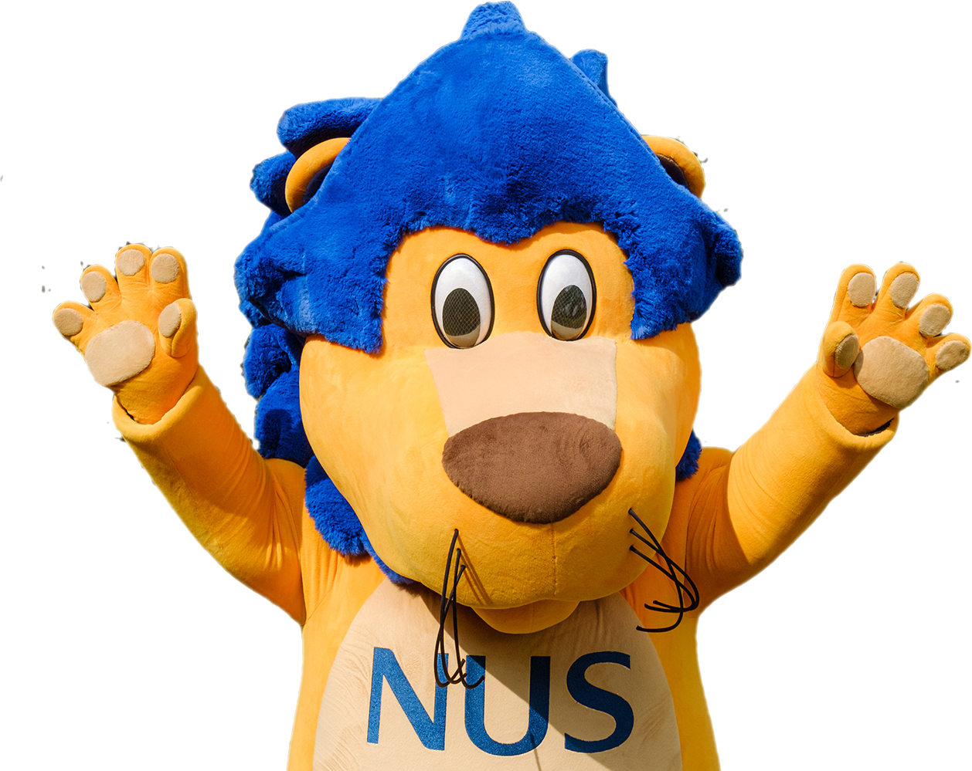
Hello Lions!
Seeking an Investment of:
A+
Entrepreneurs:
Chong Xern, Daphne, Ella, Evan and Stanley

Slide 3
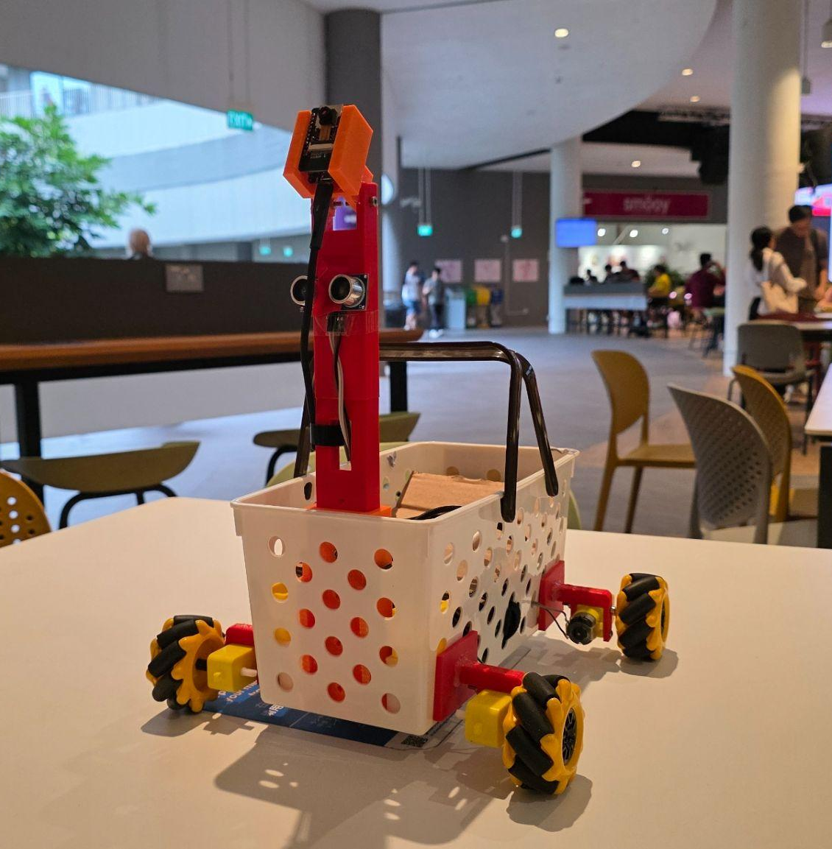
UGLL-E
(User Guided Load Lugging Entity)
Formerly Known as:
Smart Movers
Entrepreneurs:
Chong Xern, Daphne, Ella, Evan, and Stanley

Slide 4

Have you ever experienced this?
I could really use an extra hand, I need to check the bus app

Slide 5

What about this?
These groceries are just too heavy for me to carry

Slide 6
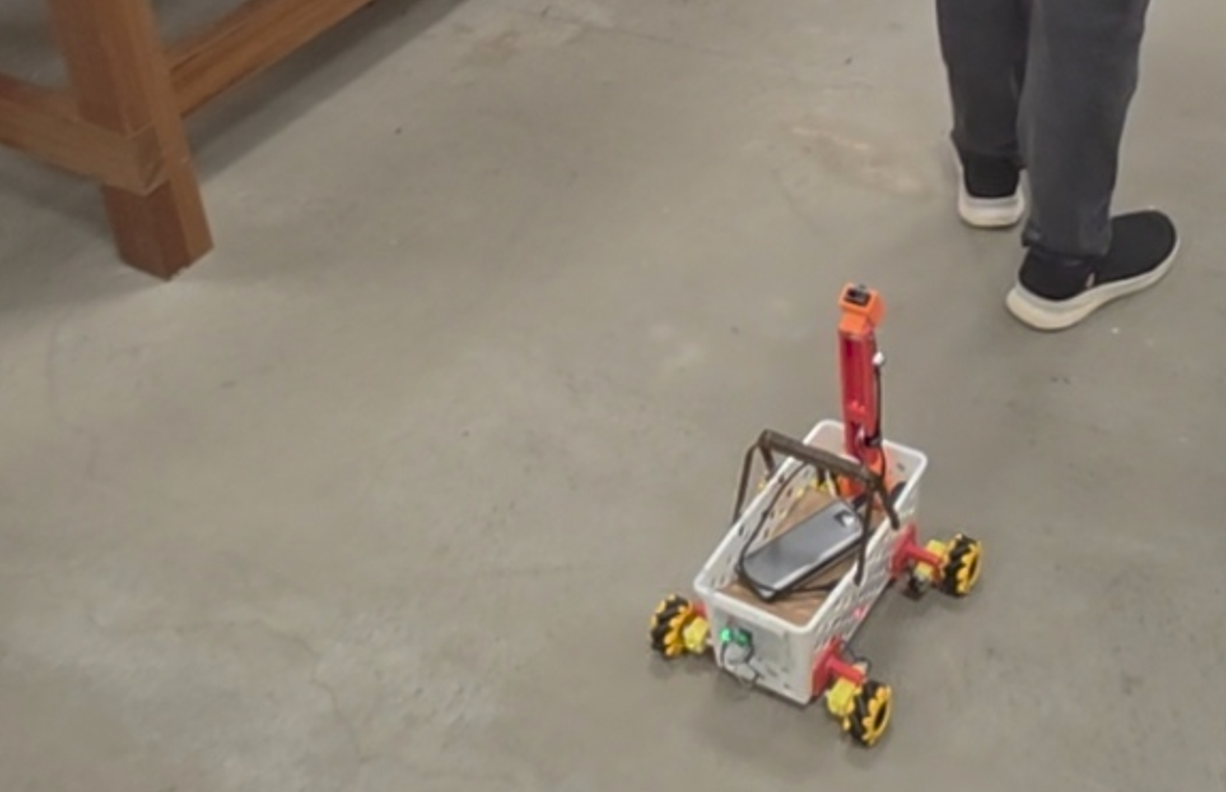
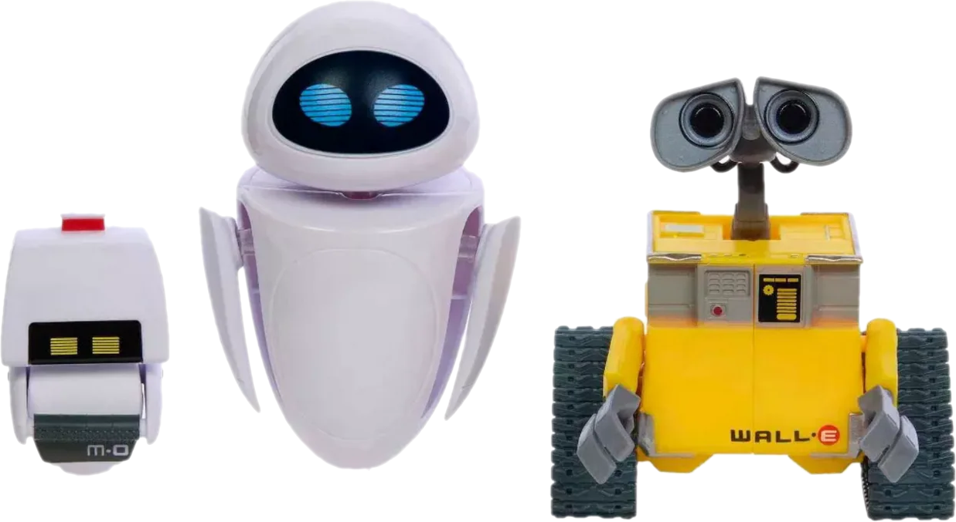
Ugll-E’s Here to Help!

Slide 7
Market Opportunity
0%
100%
People who enjoy carrying things
People who likes to be followed by me
– Ugll-E
[Sample space: 1]

Slide 8

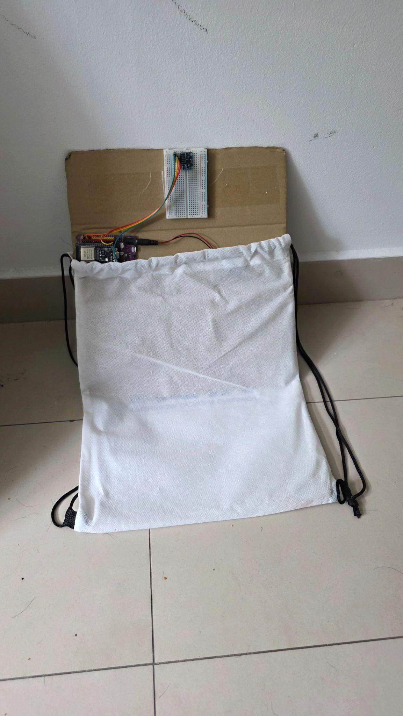
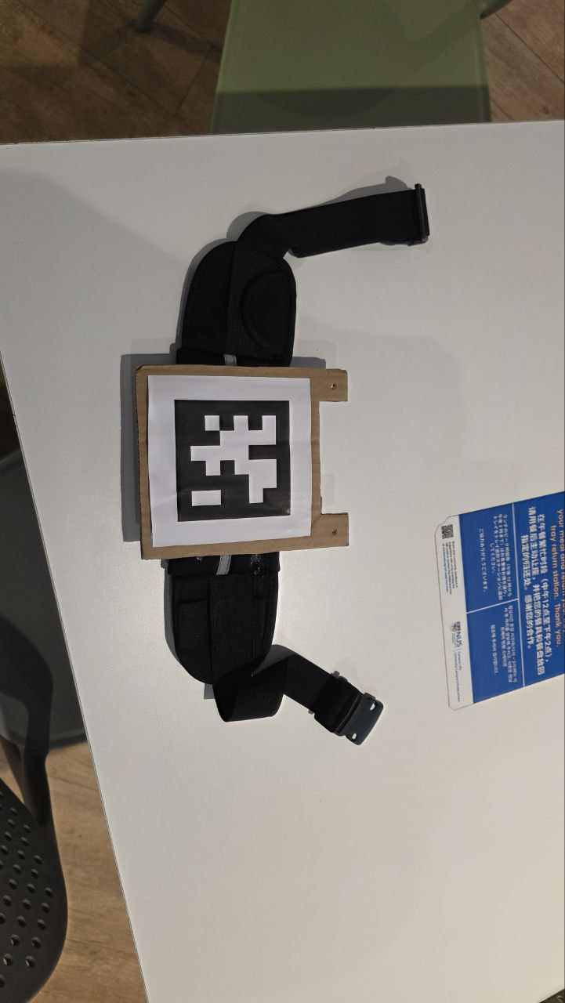
Components
UGLL-E
EVE
(Event Vector Evaluator)
M-O
(Meta-Object)

Slide 9
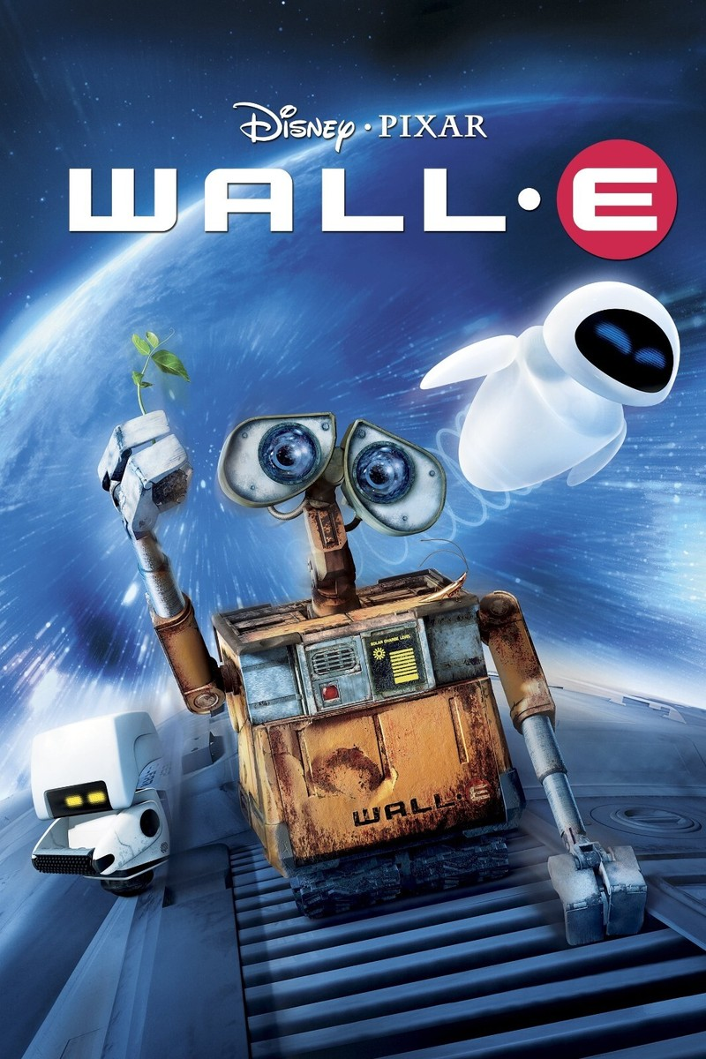
Movie Time?

Slide 10
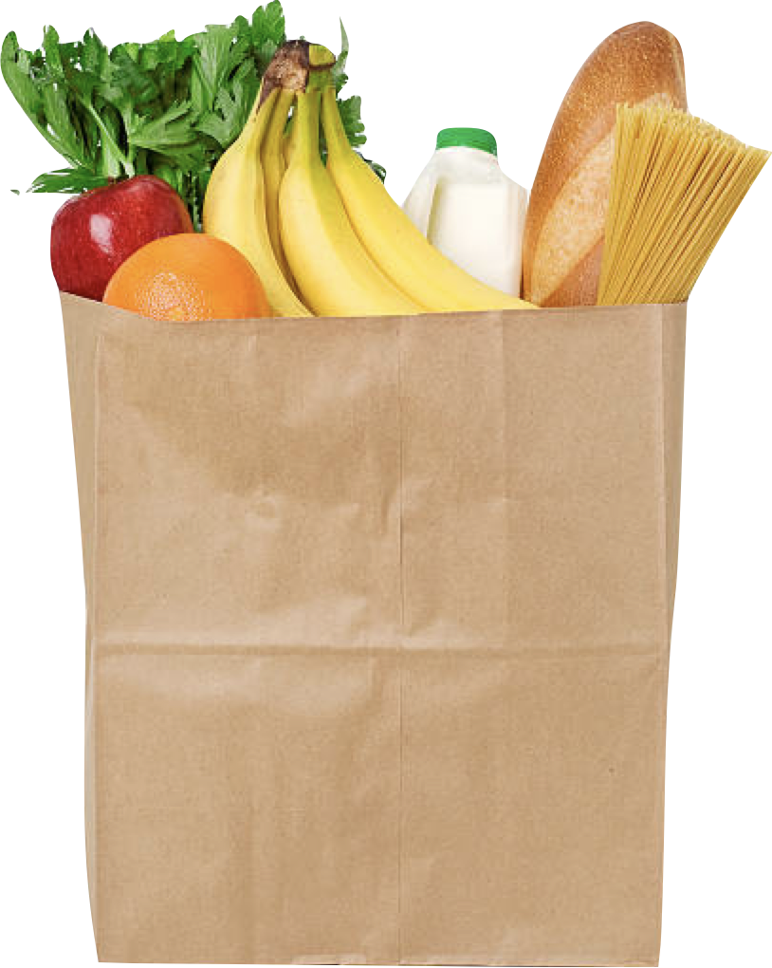
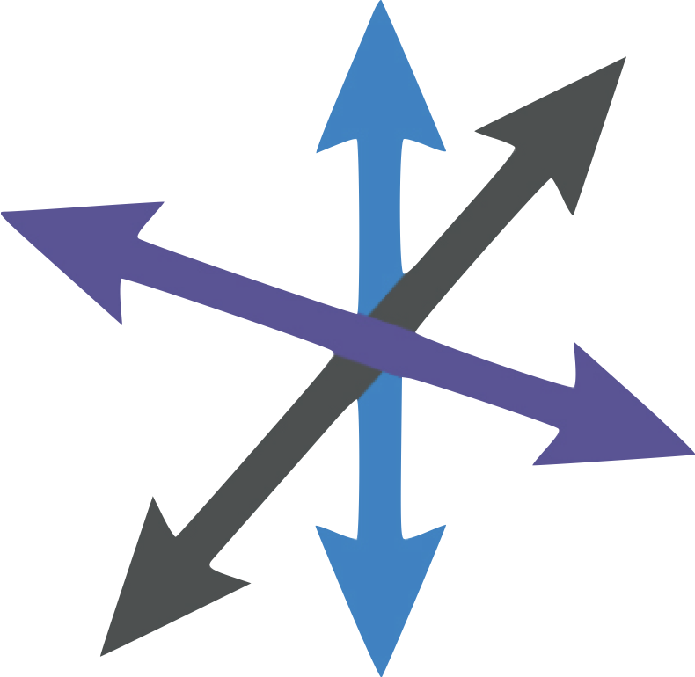


No.
Demo Time!
CS3237 • Intro to IoT
U G

Slide 11

Product Highlights
Follow -You Intelligence
UGLL-E’s Eyes (Camera) tracks M-O (April Tag) to keep it following you as you walk straight
EVE (IMU motion predictions) tells UGLL-E when you turn left/right or jump

Slide 12
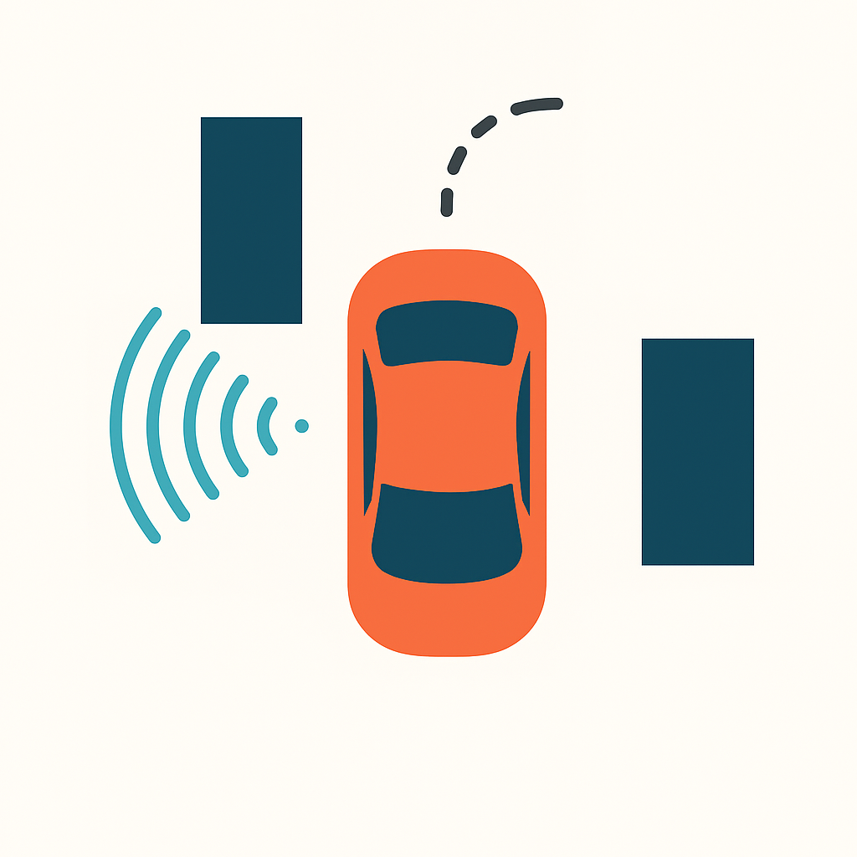
Product Highlights
Obstacle Awareness & Safety
UGLL-E uses “super-power” ultrasonic sensing to detect nearby obstacles
If something gets too close, UGLL-E slows down, stops, and yells loudly
User receives a push notification instantly

Slide 13

Product Highlights
Energy Efficient:
UGLL-E lasts: rand() % (INT_MAX + 1) minutes
Power via Power Bank
UGLL-E can be put to sleep when not in use
Turn UGLL-E on/off using a button with an LED indicating sleep status. Another led indicates WiFi connection status.

Slide 14
Product Highlights
Power Management & LED Feedback
UGLL-E includes hardware deep-sleep controlled by a single button
The LED indicators provide clear feedback: Wi-Fi connection status, stop signals, and special states like a jump command

Slide 15

Product Highlights
Smooth Motor Control
UGLL-E features soft acceleration (0 → 50% → 70% → 100%) and soft braking (70% → 50% → stop) when obstacles appear for safer movement

Slide 16
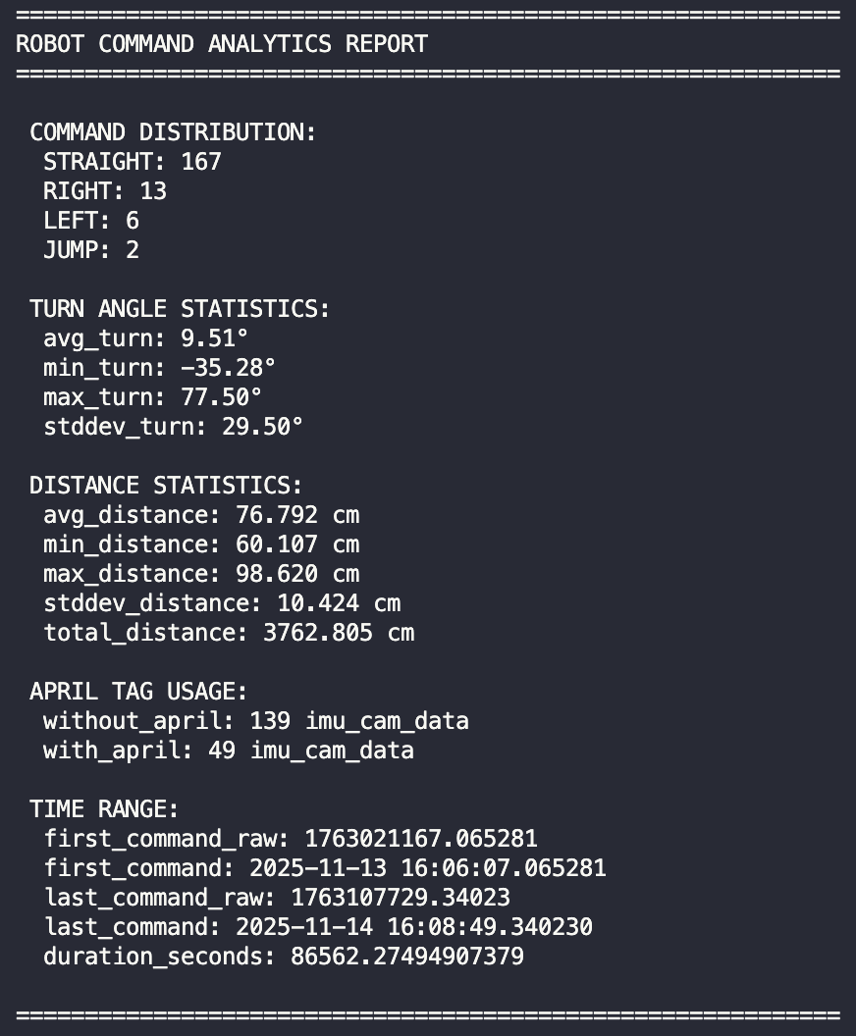
Product Highlights
UGLL-E Analytics
See historic analytics on data collected and saved to the database by the system through a comprehensive report.

Slide 17
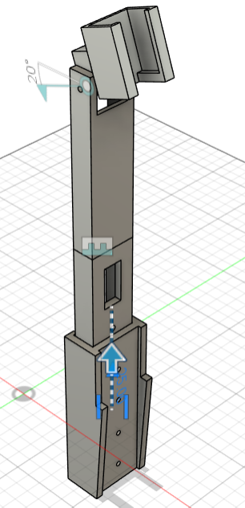
Product Highlights
Modular Camera Mount
Camera mount is modular with adjustable height and angle for the camera

Slide 18
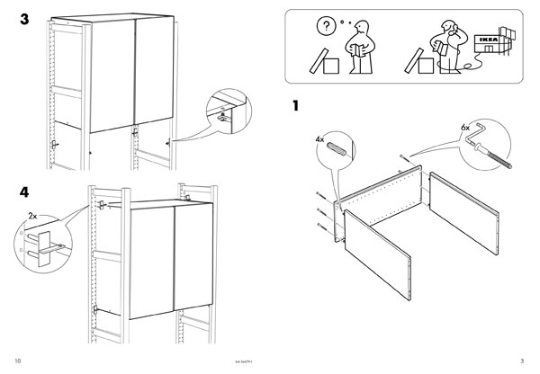
What’s in the Box
Some assembly required…

Slide 19
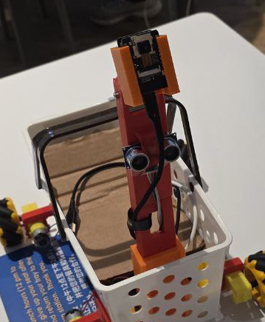
What’s in the Box
UGLL-E Components
(3) Breadboard
(2) ESP32 Board
(1) ESP32 Cam
(1) 3D Printed Camera Bracket
(1) Buzzer
(1) Basket
(4) Motors
(4) 3D Printed Motor Attachment
(1) Ultrasonic Distance Sensor
(1) Button
(2) LEDs
(2) 3D Printed Battery Holder
[Power bank not included]

Slide 20
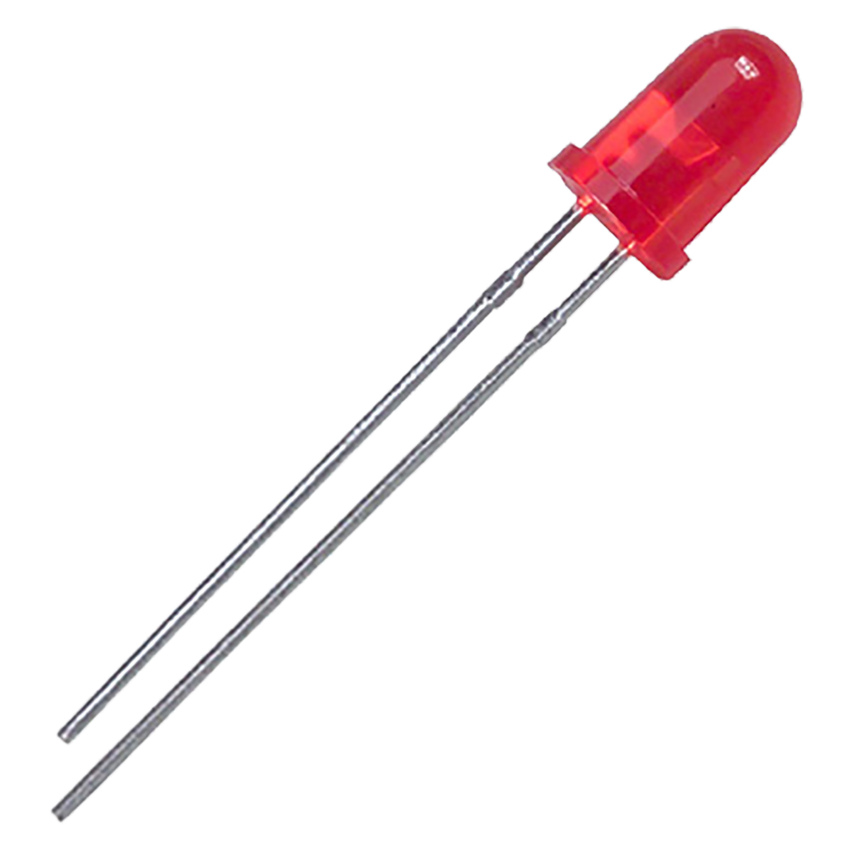
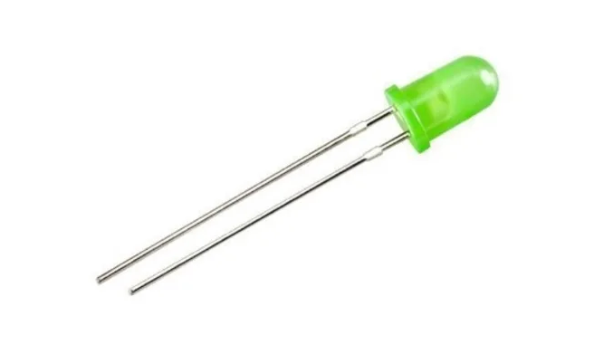
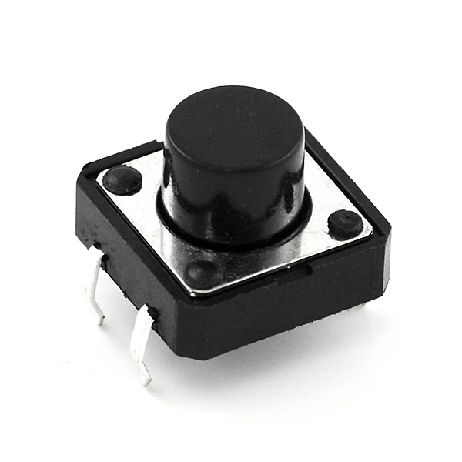
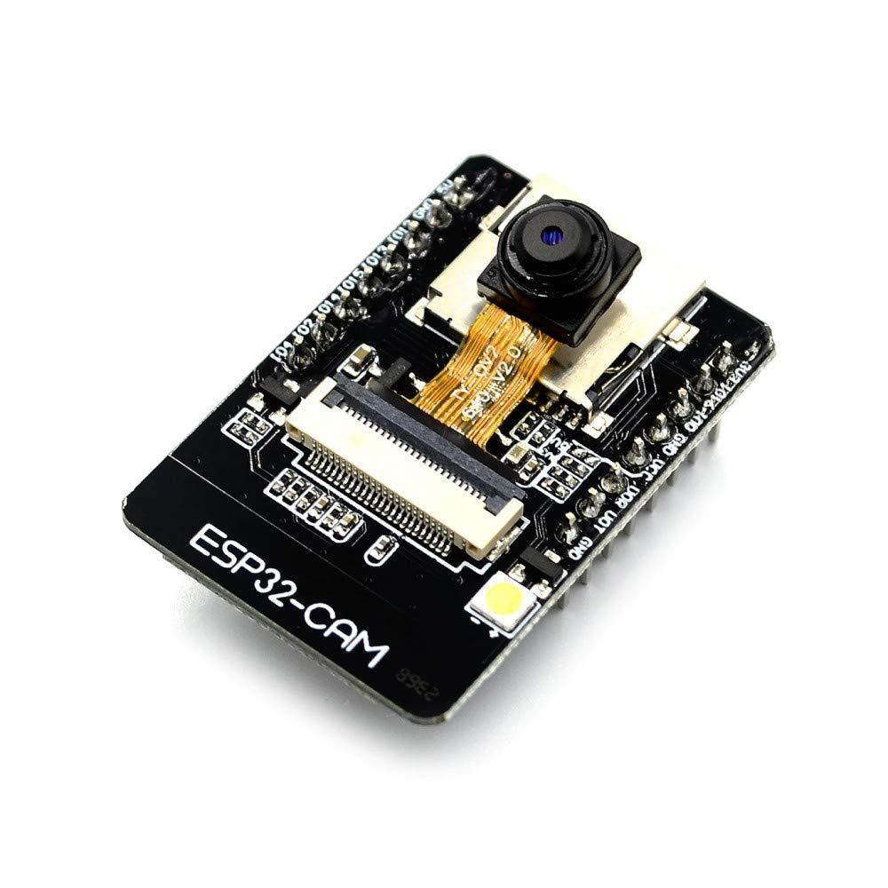
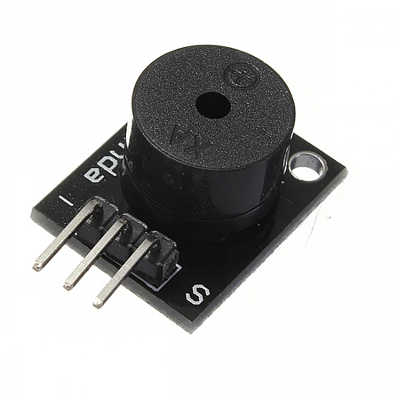
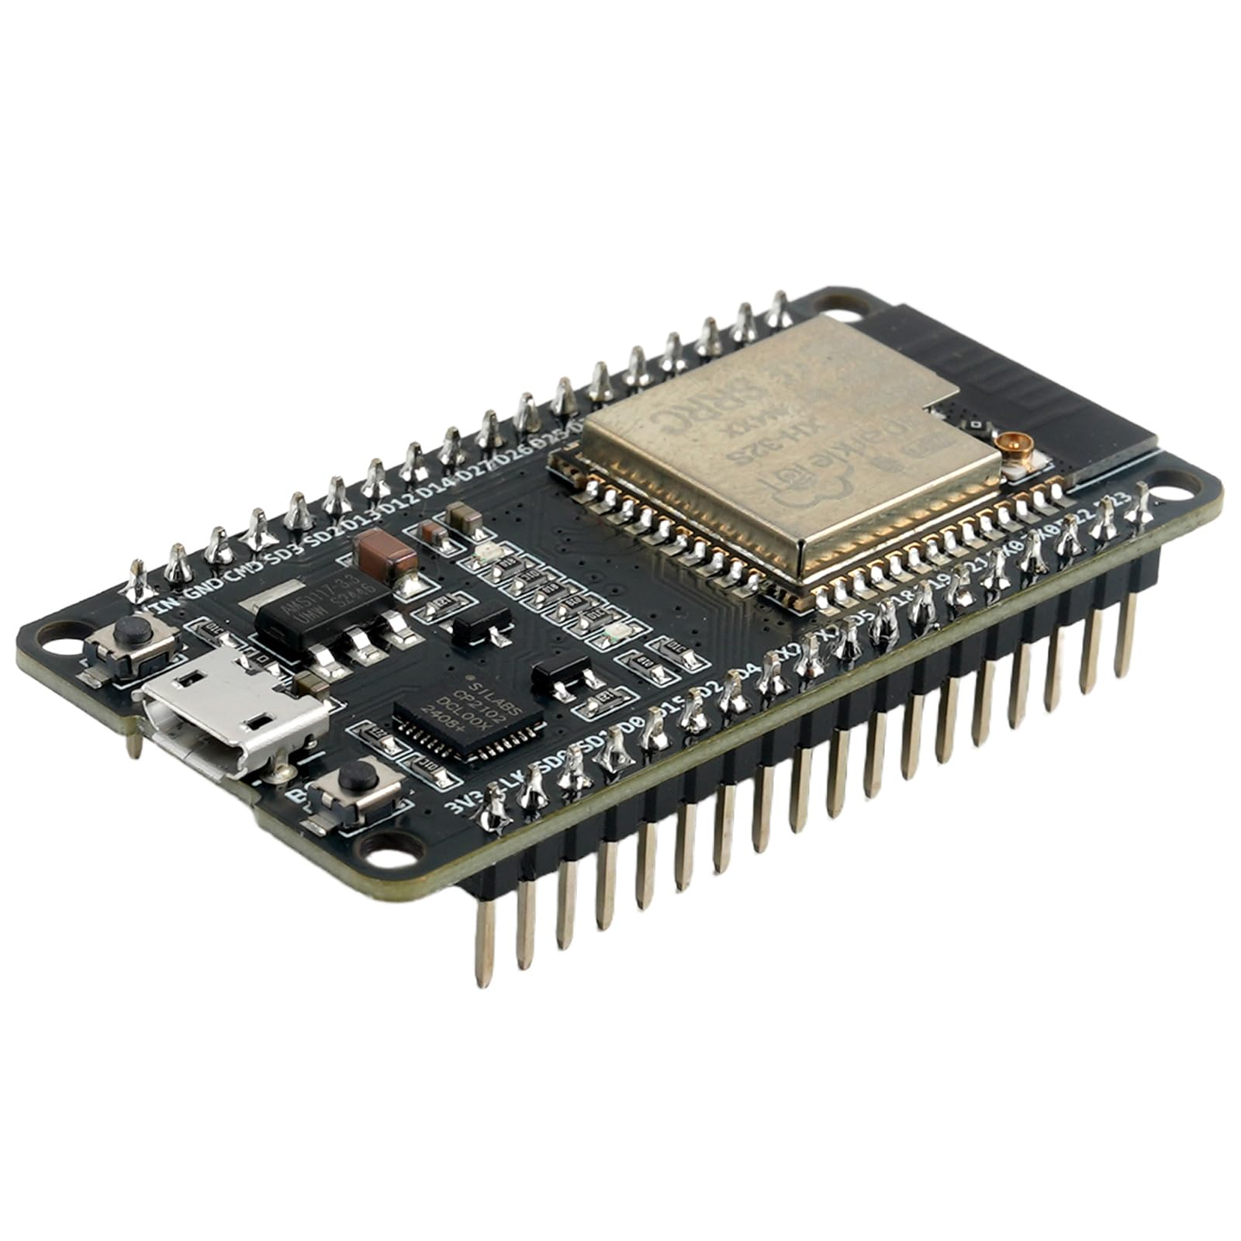
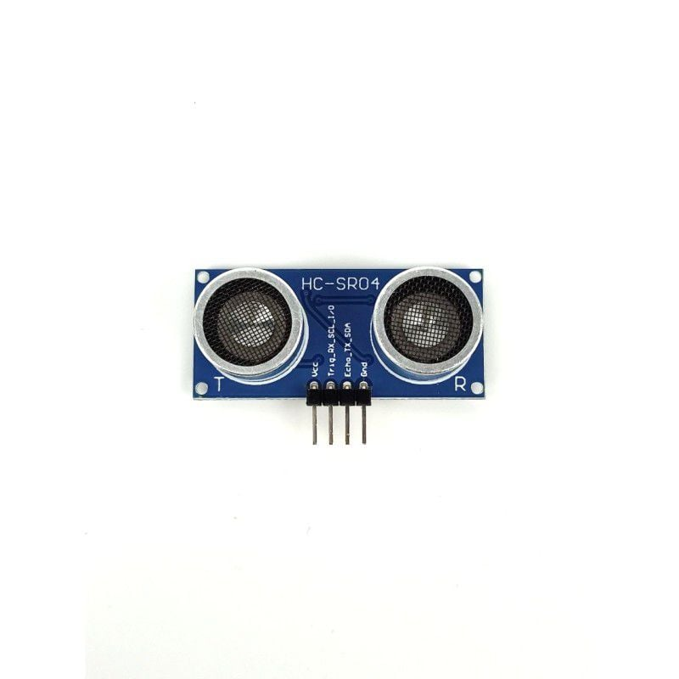
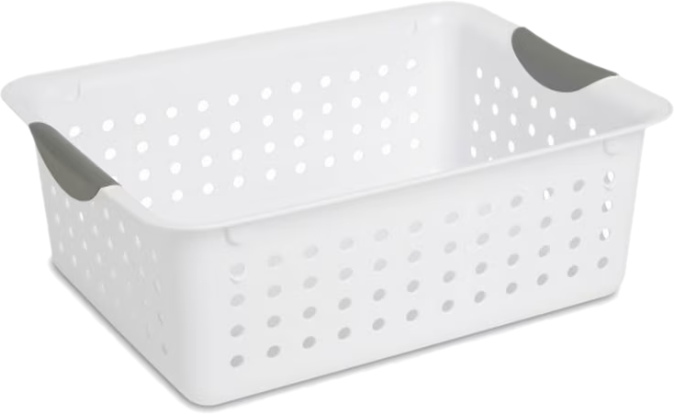
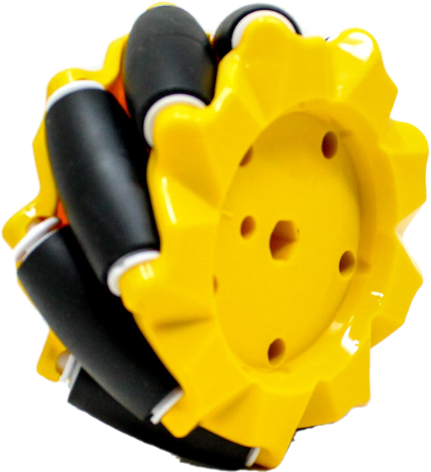
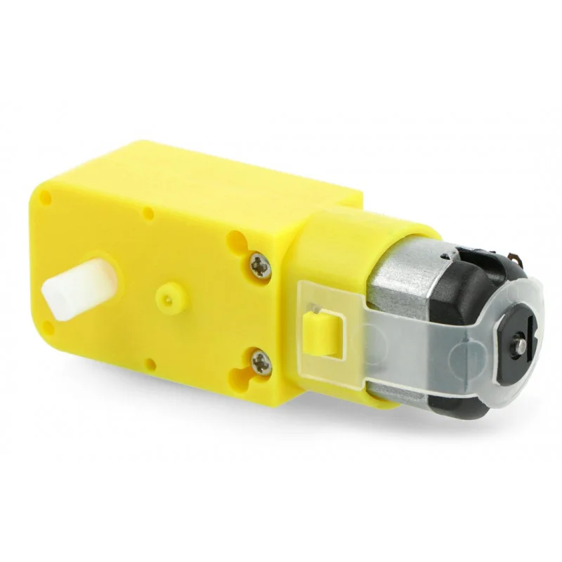

Slide 22
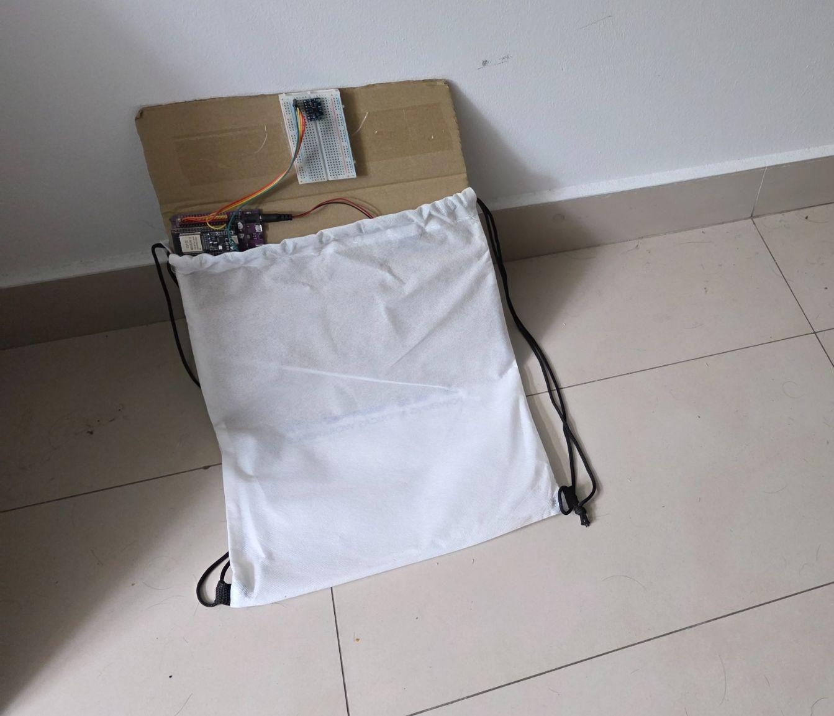
What’s in the Box
EVE Components
(2) Breadboard
(1) ESP32 Board
(1) IMU
(1) Cardboard Backing
(1) Battery
[Proprietary Drawstring Backpack sold separately: Only $3237!]

Slide 23

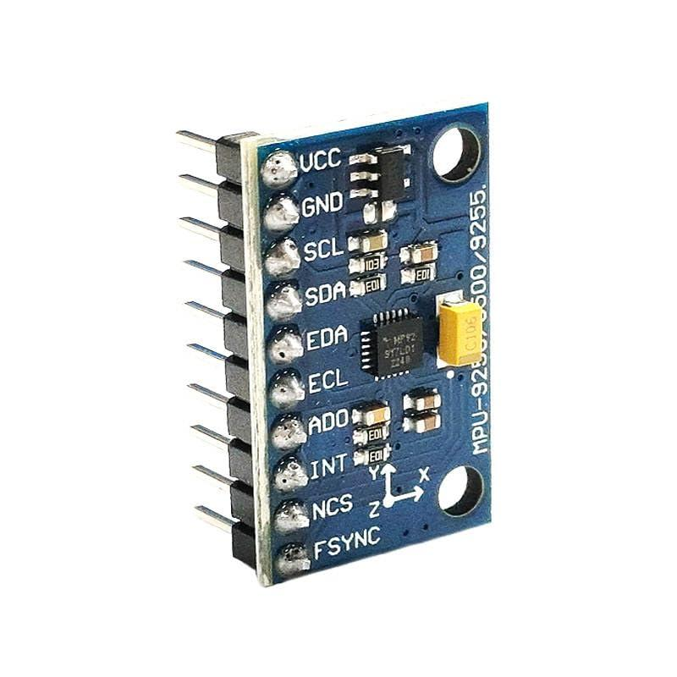
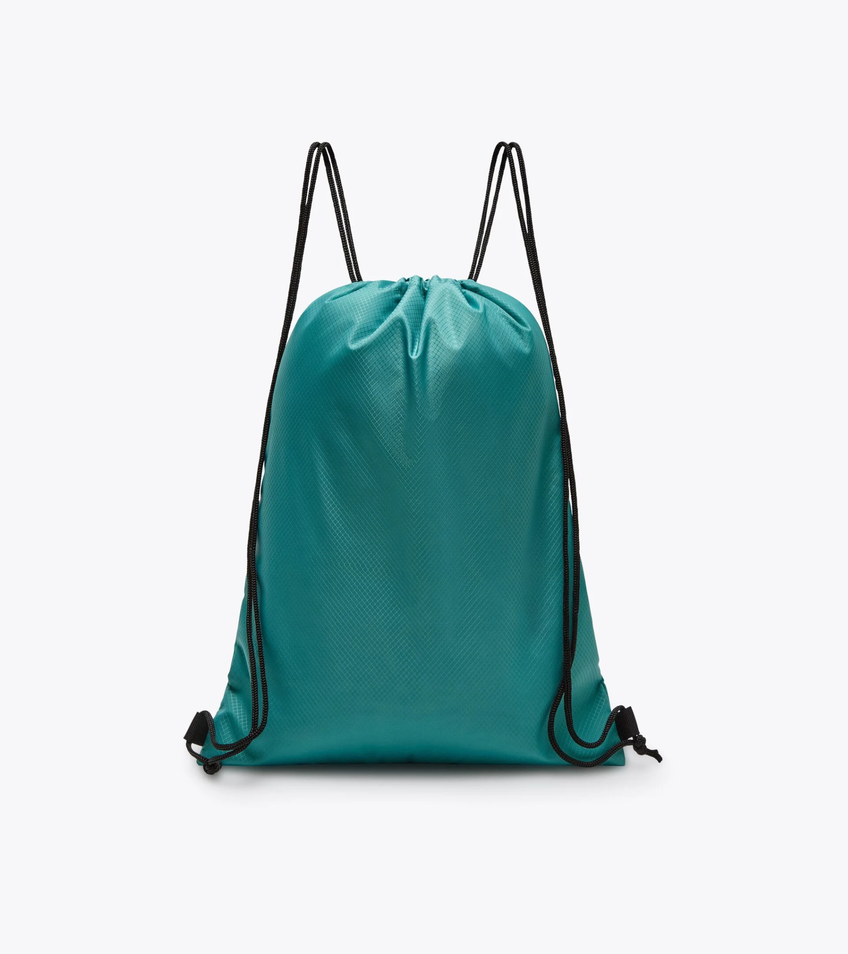

Slide 24
What’s in the Box
M-O Components
(1) April Tag
(1) Cardboard Frame
(1) Waist Strap

Slide 25

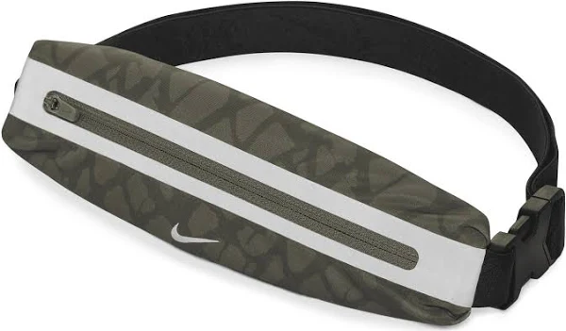

Slide 26
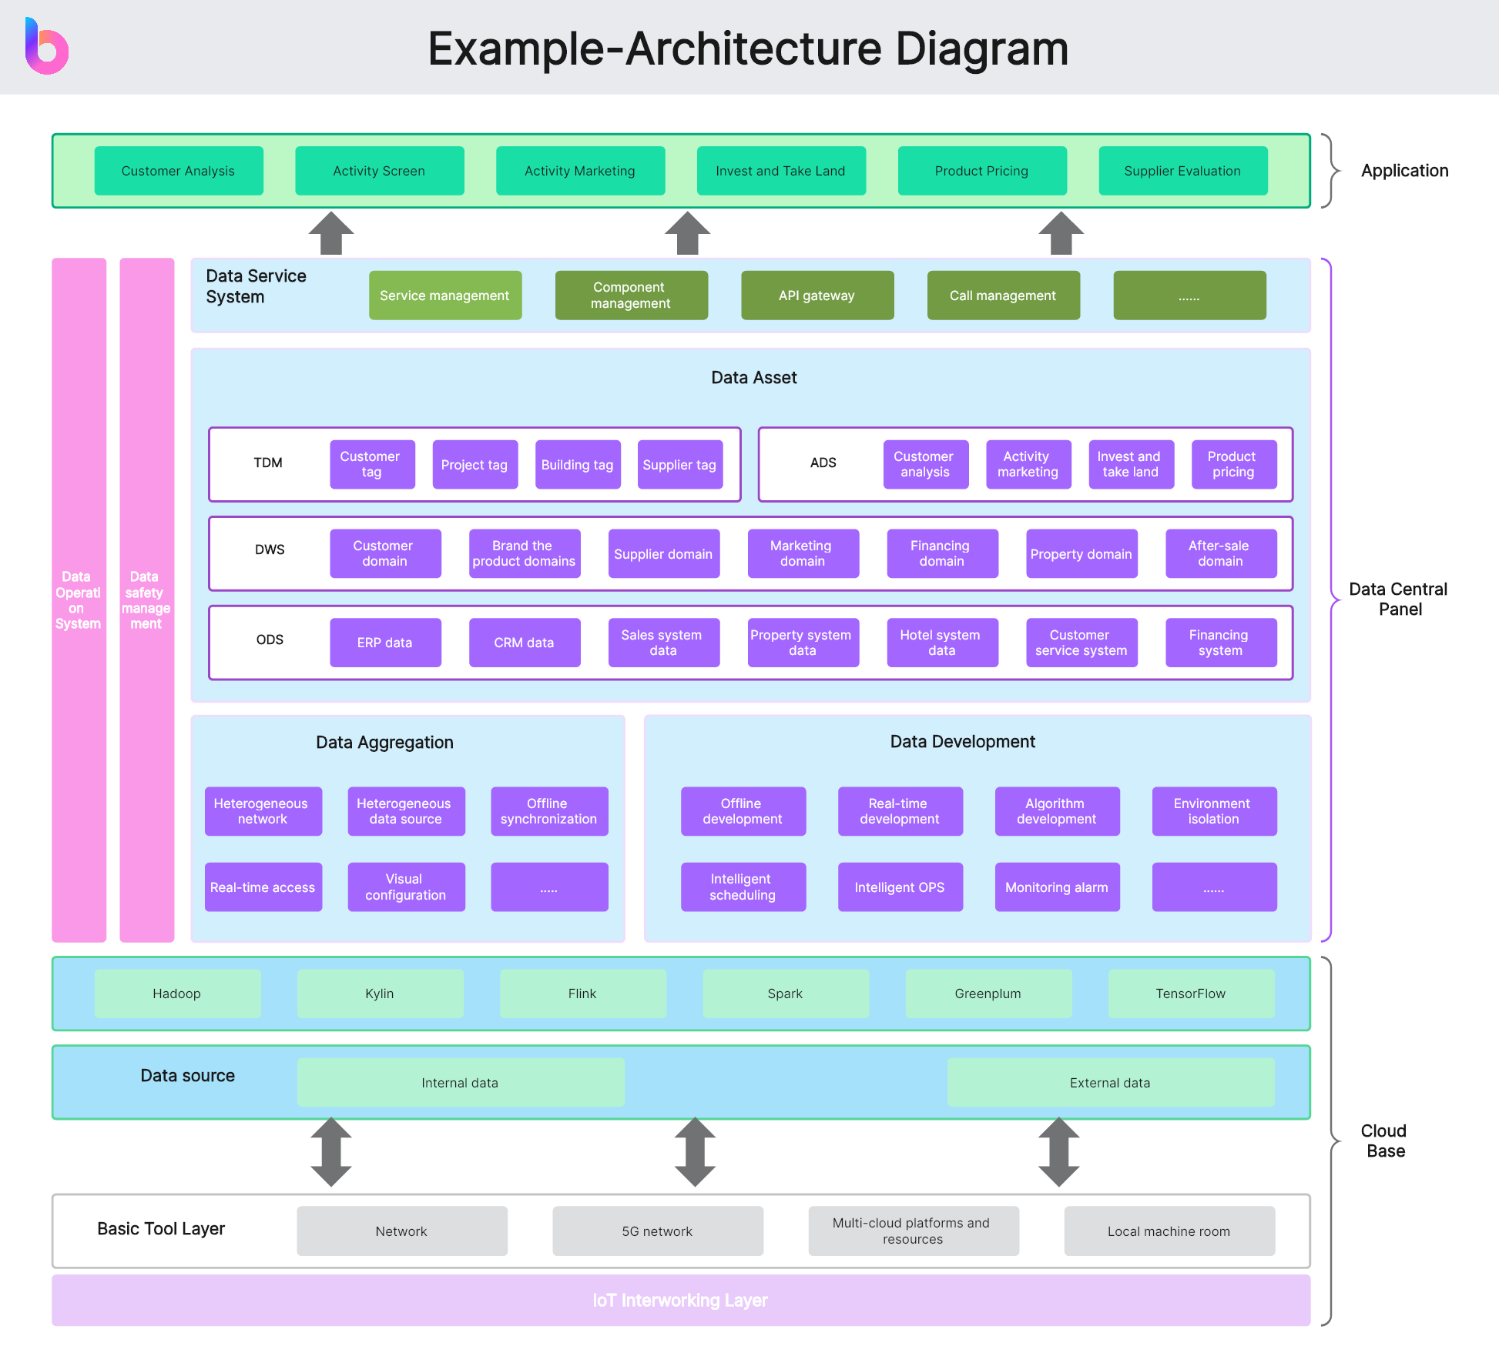
The System’s Architecture
How everything interacts with each other.
🔗

Slide 27
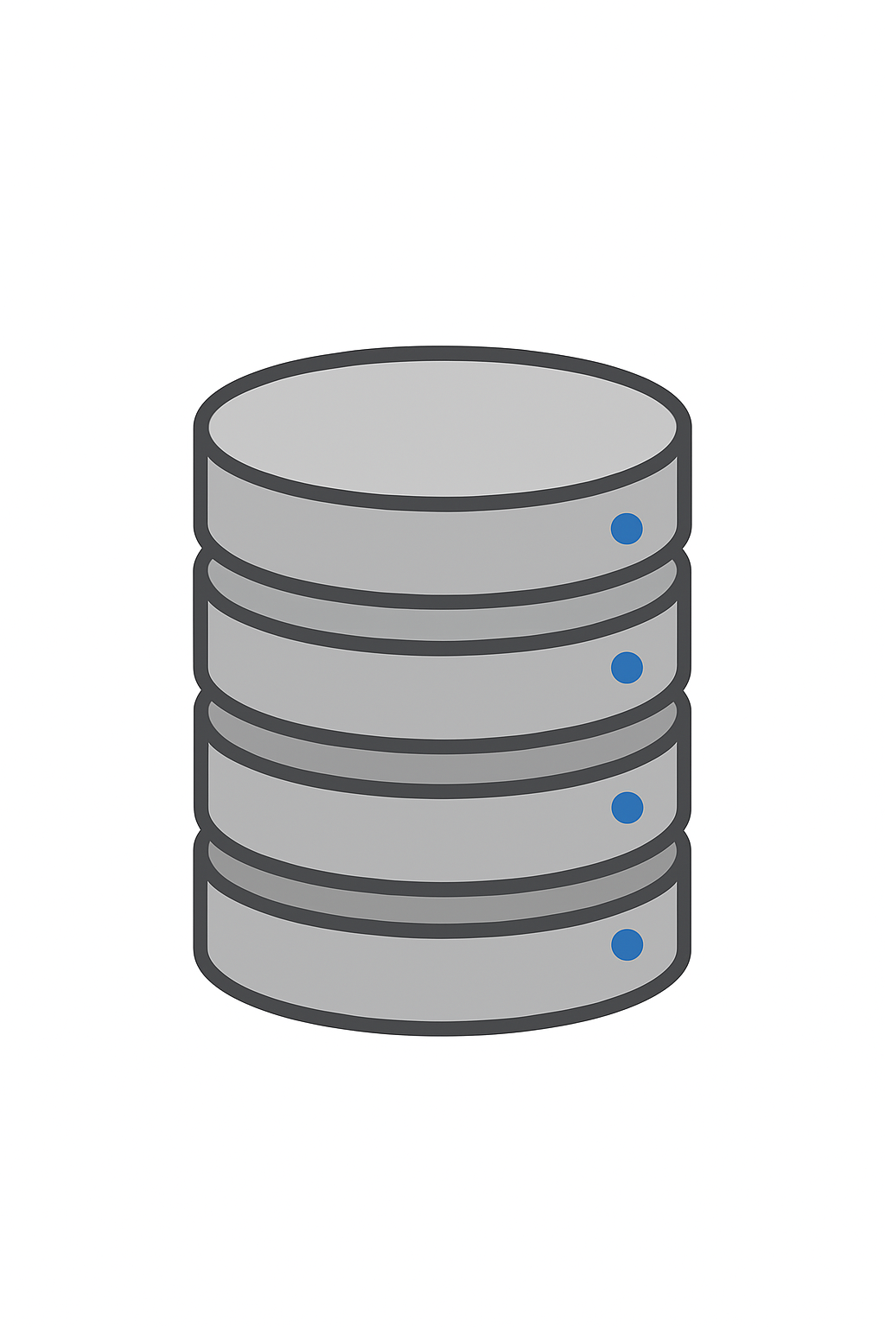

Our Servers
How we steal your data. The brains of your product. Subscription only $10.54/month
Server 1
Server 2
Server 3
Main Server
IMU Server
Cam Server

Slide 28
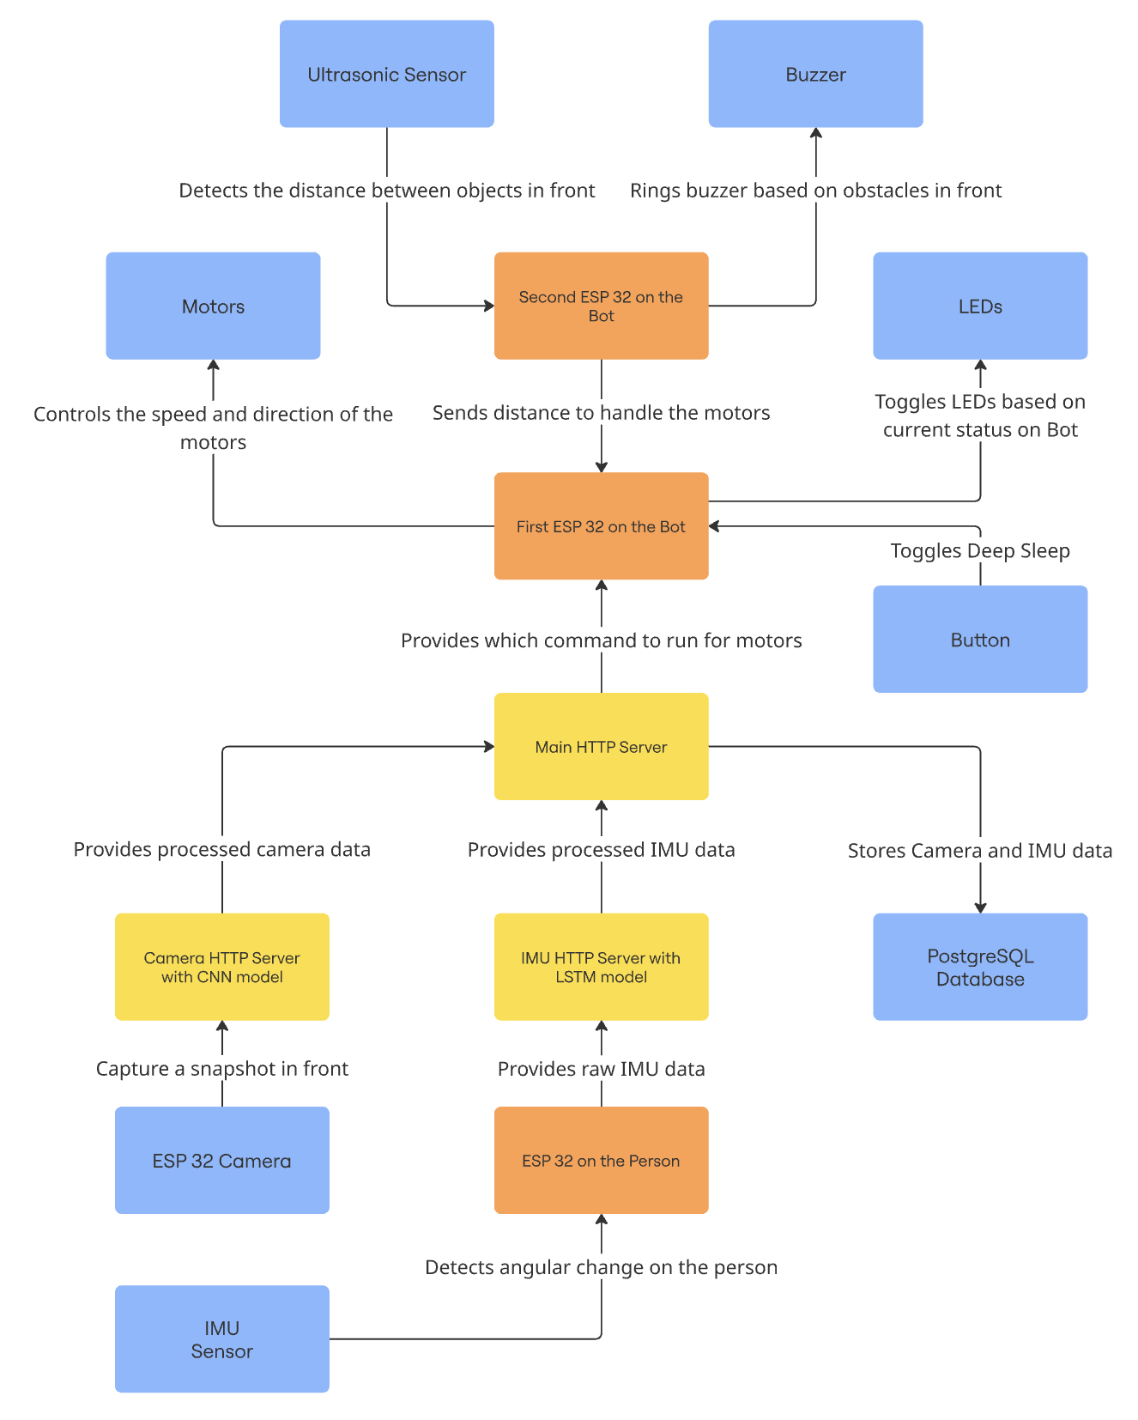

Slide 29

PostgreSQL
Insert Query
Insert Data
to Database
LSTM
CNN
HTTP GET
Direction
HTTP GET
Distance
HTTP GET
Command
HTTP Post
IMU Data
HTTP Post
Camera Detected April Tag Corners
Object Detection

Slide 30
Making Decisions
How does UGLL-E Server tell UGLL-E to move?
🤔

Slide 31
Jump
Straight
Left
Right
Stop
Highest
Priority
Lowest
Priority

Slide 32

Future Updates
UGLL-E will receive 3.141592 years of hardware and software updates
Variable speed (better motor)
Enhanced Obstacle Handling
Better Camera
Local ML (edge computing)
Optimize connection speed
Wi-Fi
MQTT
Power optimizations for M-O and EVE
Live data analytics

Slide 33
Who’s going to invest in something that’s UGLL-E!?

Slide 34
